Slide 1


Parent Meeting
Year 1 Phonics Check
Kindness Respect Responsibility
Chesed Kavod Achrayut

Slide 2
What is the Phonics Screening Check?
A word-reading test at the end of Year 1.
Children read 40 words.
Some of these words are nonsense/alien words.
https://schools.ruthmiskin.com/training/view/tbu1QnYe/yQKFDmxJ
The phonics screening checks will take place week beginning Monday 9th June
Notes:
Children complete the phonics screening check at the end of Year 1 so that parents can be confident their children are being taught to read successfully.
Children read 40 words. It takes between two and five minutes.
If they do not manage to read 32 of the words successfully, they are given extra support, and repeat the check at the end of Year 2.
It means that all children will be able to read accurately before they begin Year 3.

Slide 3
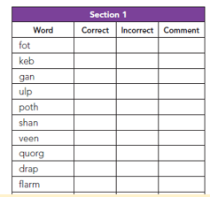
What happens during the check?
The check contains 40 words.
Each child will sit one to one and read each
word aloud to their teacher.
The check will take approximately 4-10 minutes per child although all children are different and will complete the check at their own pace. The check can take place over more than one day if necessary.
The list of words the children read is a combination of 20 real words and 20 pseudo words (nonsense words).

Slide 4
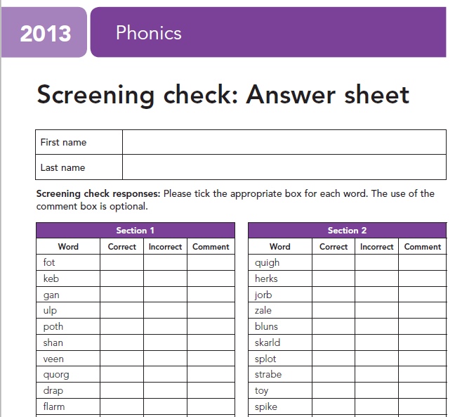

We put a tick in the correct column if the child reads the word accurately.
We also tick the incorrect column if the child does not get the word correct because we do not want them to feel anxious if they see a cross or a dot which could then impact negatively on the rest of the phonics check.

Slide 5
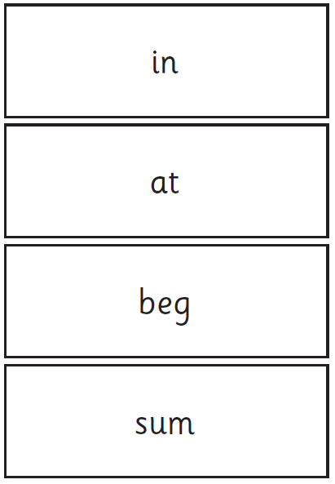
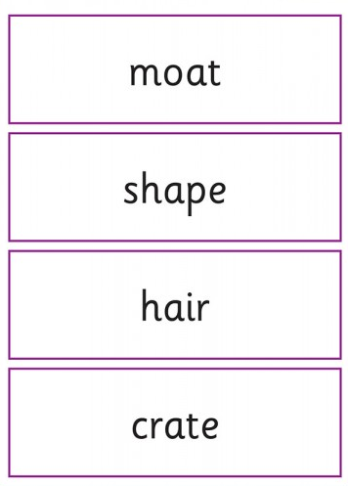
Example of the Real Words:

Slide 6
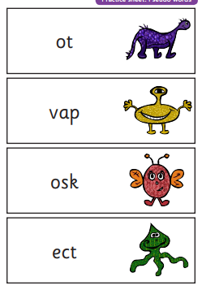
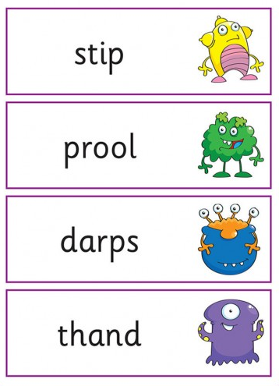
Examples of the nonsense words:
Notes:
Children can identify sounds with dots and dashes as they “sound out”- show example of this.

Slide 7



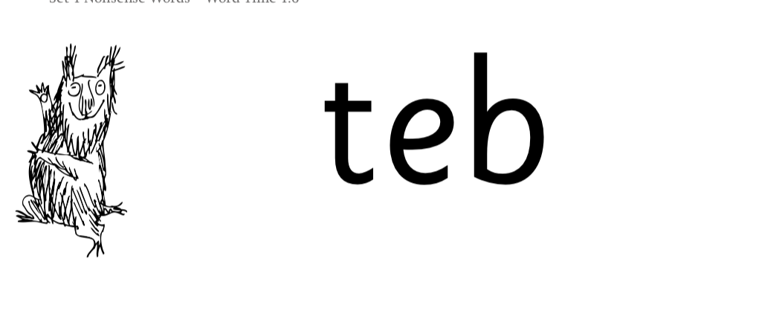
Nonsense words
Notes:
Half of the words in the check are real words.
Half are nonsense words. For example, ‘sheb’, ‘glight’, ‘ched’, ‘teb’.
There is a picture of an alien next to each word to remind the children that it isn’t a real word.
Nonsense words are used to assess children’s reading.
They check that children will be able to read sounds the sounds they know in unfamiliar words.
They read these words using the same routine as real words – ‘Special Friends, Fred Talk.’
Children who can read nonsense words will, very soon, be able to read any new word – for example – gargantuan, flailing, raucous, anticipation;
Reading new words increases children’s vocabulary rapidly.

Slide 8
Reporting the results
By the end of the summer term, all schools must report the results to the Local Authority.
Data from the check will be used by DfE to determine which pupils have not met the expected standard in phonics.
Y1 Children not meeting the standard will be able to re-take the check in Year 2.
You will be notified of the results after they have been submitted and collated by DfE. Schools must report pupils’ results to parents in their annual reports.

Slide 9
What can I do?
Help your child to use ‘Special Friends’, ‘Fred Talk’ to read words.
Practise reading sounds speedily.
Watch the Virtual Classroom films together.
Listen to your child read their Storybook every day.
Have a go at the PSC materials- remember its not about memorising words.
Read as much as possible to and with your child - encourage your child to sound out any words they are unsure of.
Notes:
Help your child to use ‘Special Friends’, ‘Fred Talk’ to read words.
Practise reading sounds speedily.
Watch the Virtual Classroom films together.
Listen to your child read their Storybook every day.

Slide 10
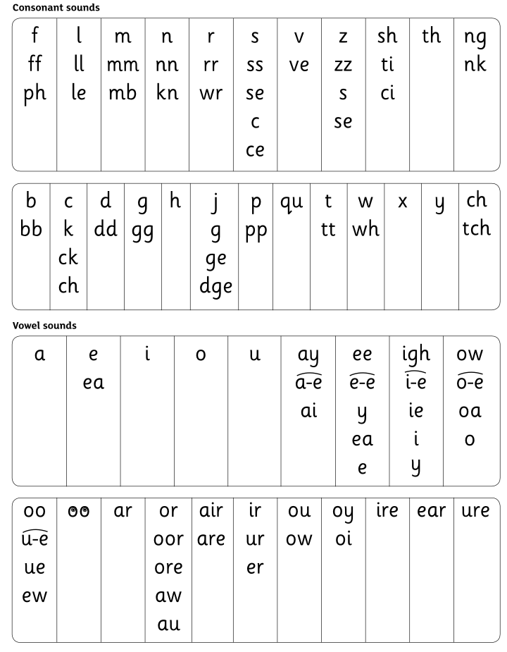
Speed Sounds Set 3
Notes:
Children learn all of the sounds on this chart.
Once they know all of these sounds, they will be able to read any unfamiliar word.

Slide 11
Online resources available
Ruth Miskin Families Page:
https://www.ruthmiskin.com/parentsandcarers/
Ruth Miskin Facebook:
https://www.facebook.com/miskin.education
Games: https://wordwall.net/resource/19873648/rwi-phonics-set-3
https://wordwall.net/resource/19873479/rwi-phonics-set-2
https://wordwall.net/resource/11648030/phonics/phase-3-real-and-nonsense-words

Slide 12
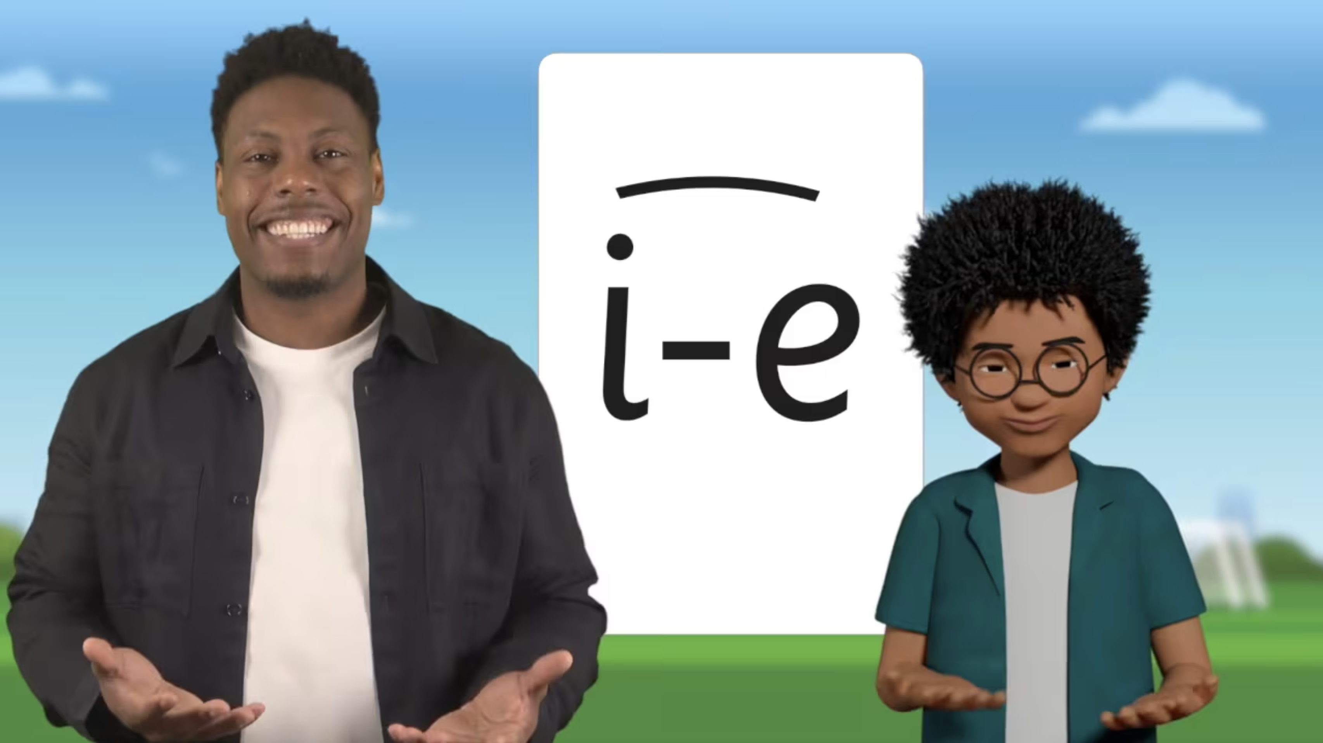
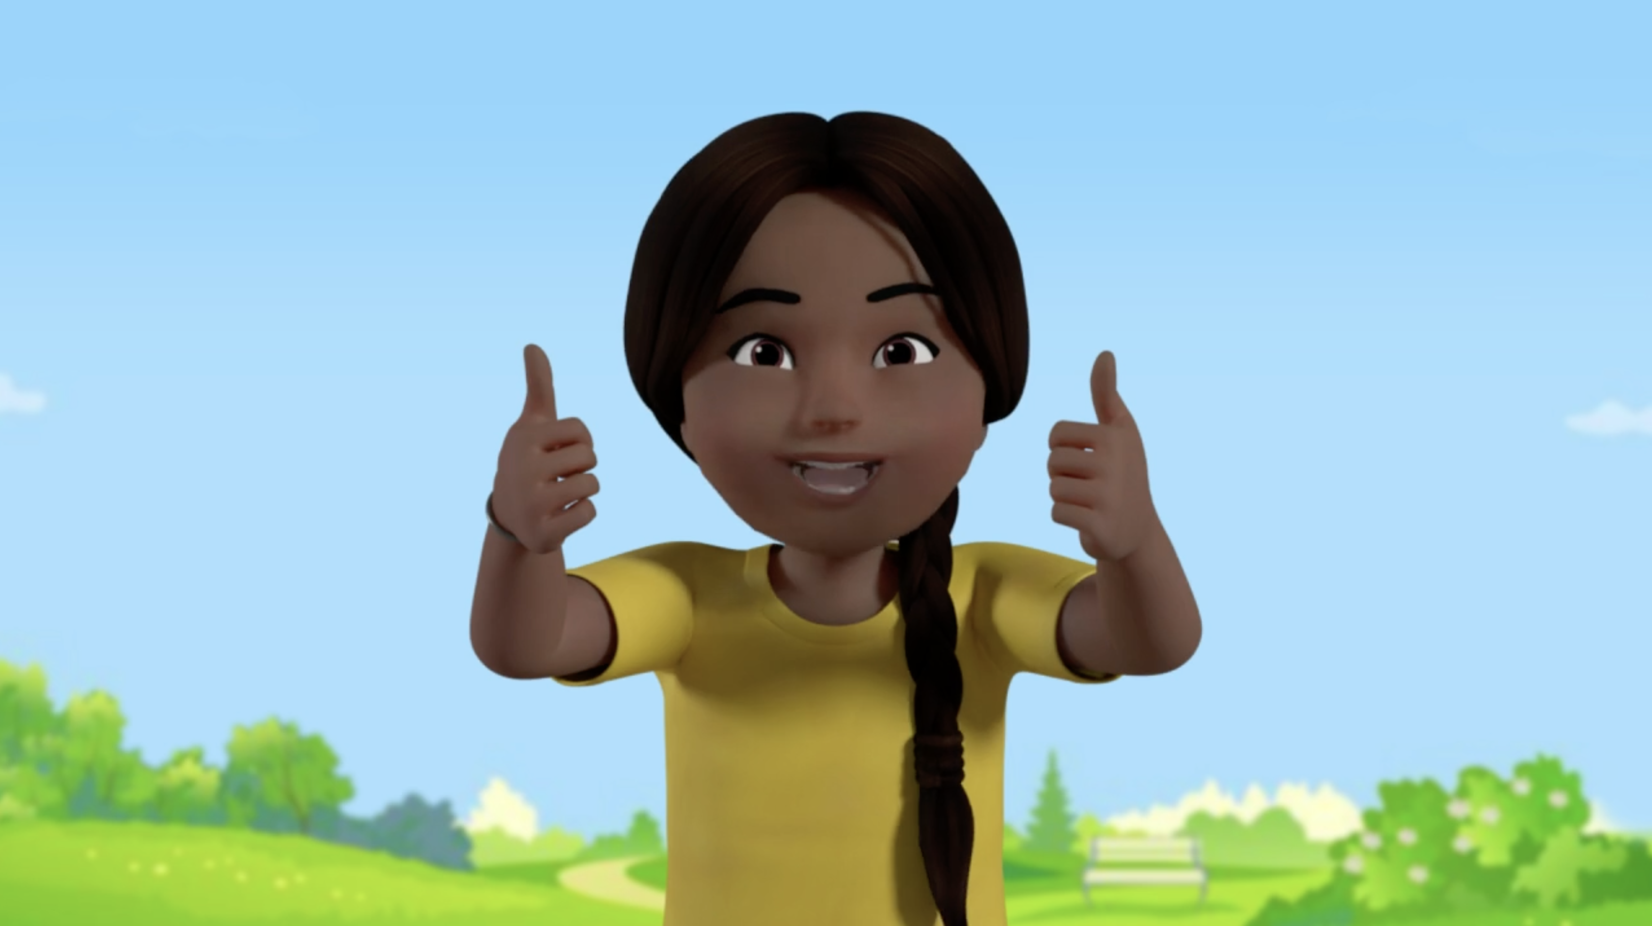
Virtual Classroom films
Links to watch at home- more time on the sounds!
https://schools.ruthmiskin.com/training/view/w2WKmBOf/NdEQHzGw
Notes:
Each week, we will send home film links to lessons that match the sounds and words your child has been learning in school.
Plus 5-minute Word Challenge films.
Your child uses the Virtual Classroom in school.
Children are familiar with the VC teachers and characters – and interact with them as they would their own teacher.
Watch these films with your child to help them to practise reading the sounds and words until they can read them speedily.
The more they practise using these films, the quicker they’ll learn to read.
Simply click the link or scan the QR code and watch on a tablet or other device.
Let’s have a look at one of these films on the Virtual Classroom. Play a Set 2 or 3 Word Challenge film from the virtual classroom.

Slide 13

Remember: ’Special Friends’, ‘Fred Talk’
Notes:
We teach children to words using the routine ‘Special Friends’, ‘Fred Talk’, read the word’.
Children spot the ‘Special Friends’ (two letters that make one sound), Fred talk the word, and then read the whole word.
For example, ‘sh’, sh-i-p, ship.

Slide 14

Any questions?

